Slide 1


Migrate. Innovate. Enable
Unlock the full power of Azure
Internal presentation
Website: www.snp.com
Contact Email: sales@snp.com

Slide 2

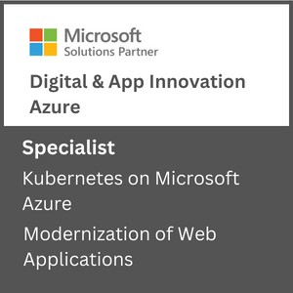
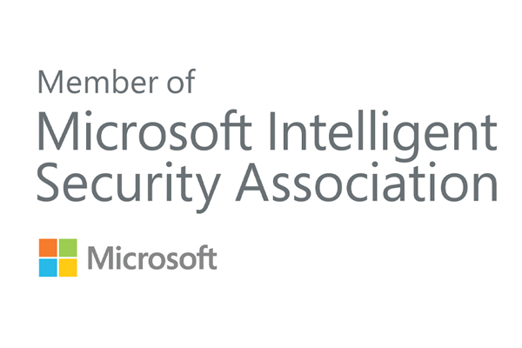
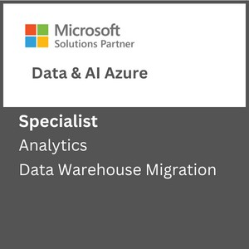
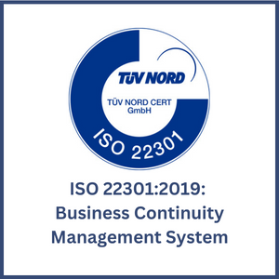
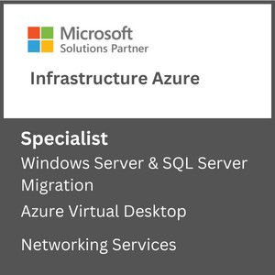
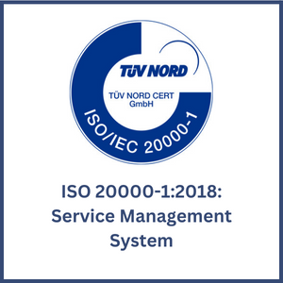

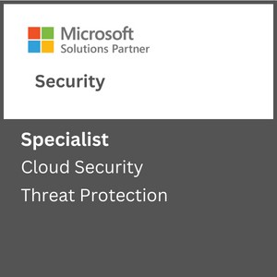
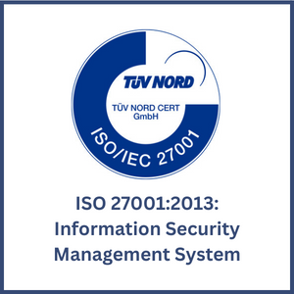

About SNP
Driving Innovation & Business Excellence with Microsoft Azure in:
SNP is Azure Innovate Ready helping transform businesses with innovative, cloud-based solutions that harness the power of Microsoft Azure. We are 100% Azure Focused. 100% SMC Focused. and 100% Certified for Different Microsoft Funding Programs like SA, PIE, ECIF, AMM and AAAP.
SECURITY
Defend Against Threats with SIEM Plus XDR
Secure Multi Cloud Environments
Secure Identities and Access
Protect and Govern Sensitive Data
Mitigate Compliance and Privacy Risks
DevSec Ops
MICROSOFT ADVANCED
SPECIALIZATIONS
APPS & INFRASTRUCTURE
Migrate and Modernize Your Infrastructure and Workloads - WS/SQL on Azure; Linux/OSS DB on Azure; AVS; AVD
Protect Your Data and Ensure Business Resiliency with BCDR- Azure Backup, Azure Site Recovery, BCDR Solutions
ANALYTICS ON MICROSOFT AZURE
NETWORKING SERVICES
AZURE VIRTUAL DESKTOPS
KUBERNETES ON MICROSOFT AZURE
Migrate enterprise apps to Microsoft azure
INFRA & DATABASE MIGRATION TO MICROSOFT AZURE
CLOUD SECURITY
THREAT PROTECTION
DATA WAREHOUSE MIGRATION
Modernize Your Workloads with Azure at any Scale with HPC plus AI- Azure specialized VMs, Azure Cycle/Batch, Storage Services, Networking Services.
Innovate Across Hybrid and Edge with Azure Arc- Azure Arc, Arc-enabled data and ML, AKS, Microsoft Defender, Azure Monitor ,Azure Stack HCI
ISO Certifications:
DevOps on Azure: DevOps Maturity Model, CI/CD, IaaC, DevSecOps
DATA, ANALYTICS & AI
Innovate with AI and Cloud Scale Databases in Every App- Azure Cognitive Services, Azure Applied AI Services, Azure Cosmos DB, Azure MySQL & PostgreSQL, Azure SQL DB, Azure ML
Migrate and Modernize Your Data Estate- Azure SQL MI, Azure SQL IaaS, Azure Arc Data, Azure Cosmos DB, Azure PostgreSQL​, Azure MySQL
MICROSOFT PARTNER AWARDS
Power Business Decisions with Cloud Scale Analytics- Azure Synapse, Azure ML, Azure Databricks & PBI
Enable Unified Data Governance- With Microsoft Purview get unified data governance across on-premises, multi-cloud, and SaaS environments
DIGITAL & APPLICATION INNOVATION
2023 PARTNER OF THE YEAR
FINALIST
Security
Modernize Enterprise Applications- Azure App Service , Azure Spring Cloud, API Management, Logic Apps, Power Apps, AKS
Innovate and Scale with Cloud Native Apps - AKS, Azure Functions, Azure Container Apps, Azure DB for PostgreSQL, Azure Cosmos DB, Azure Arc
2021 MSUS PARTNER OF THE YEAR WINNER
Business Excellence in Solution Assessments
Enable Developer Productivity and Accelerate Delivery- Power Apps, Power Automate
Accelerate Innovation with Low Code- GitHub, Visual Studio
AZURE MANAGED SERVICES
2019 MSUS PARTNER OF THE YEAR WINNER
Intelligent Cloud & OSS on Azure
CSP Hosting Services
Support Desk Operations
Managed Azure Infrastructure Operations
Managed Security Operations
Managed App Services and Kubernetes.
Optimization Services
Managed DR & Backup Operations
Managed Data Operations
Managed DevOps Services
2019 PARTNER OF THE YEAR FINALIST
Open-Source Applications & Infrastructure on Azure
LICENSE RESALE
Azure Billing & Subscription Management
CSP Management
Cloud Cost Optimization

Slide 3
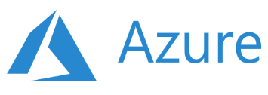
Key Focus Areas
Recent Projects
Artificial Intelligence & Machine Learning
Data Engineering Services
Database Modernization
MLOps
Solution Architecture & Consulting Services
Business Intelligence & Visualization Services
Power Bi with Synapse Analytics
Data Platform in 30 Days
Data Integration Services
Enterprise DW Modernization
Data Integration Services
ML Model Building & Consulting
ML Platform Operationalization (MLOps)
SQL Server Modernization with Azure PaaS
Power BI Governance
Power BI Development
Data, AI & Analytics
Migrate and transform data for data driven customers using solutions such as data engineering, BI and AI
Apps & Infrastructure
Hybrid Cloud
Hybrid Security Rationalization & Strategy
Cloud Infrastructure & Management
Hybrid Cloud Strategy with Azure Arc
App Innovation
DevOps & GitOps Solutions
Open-Source Solutions
Hybrid Identity
API Management
Infrastructure Rationalization & Migration Roadmap design
Servers Lift & Shift
OSS & SQL Migration to PaaS
Citrix Virtual Desktops
Windows Virtual Desktops
Hybrid Cloud Framework
Hybrid Management with Azure Arc
Compliance Policy as a Code
Hybrid Security Rationalization
.NET – Application Modernization with Azure PaaS
OSS - Application Modernization with Containers & Azure PaaS
AKS Maturity Model
Kubernetes & Containers
Red Hat Cloud Solutions
DR & Cloud Failover
Azure Sentinel & SIEM Integration
Azure Sentinel - Workflow & Connectors development
End-to-end cloud solutions which include infrastructure and operations, DevOps and automation and application modernization
Azure Managed Services
CSP Hosting Services
Support Desk Operations
Managed Azure Infrastructure Operations
Managed Disaster Recovery & Backup Operations
Virtual Desktop Infrastructure –(VDI) Operations
Managed Data Platform Operations
Managed DevOps Services
Managed Security Operations
Managed VDI Operations (Citrix & Windows VDI)
Premium Managed Services
Azure Managed Services supporting the full Microsoft Azure solution suite including infrastructure, data, security, DevOps and more
Industries We Serve
Healthcare
Biotech
Financial Services
Manufacturing
Professional Services
Engineering & Architecture

Slide 4
Agenda
Introduction of Microsoft defender for cloud.
Cloud Security Posture Management.
Security recommendations.
Security score.
Attack Path Analysis.
Security Alerts.
Regulatory compliance.
Workload protection.

Slide 5
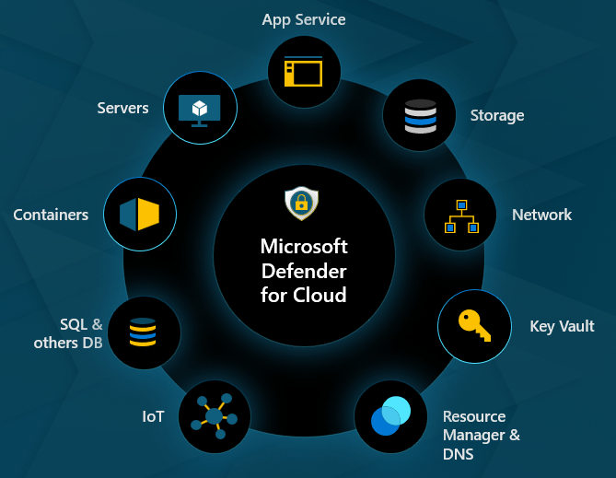
Microsoft defender for cloud:
Microsoft Defender for Cloud is a unified cloud native application for cloud security posture management and workload protection solution that finds weak spots across your cloud configuration, helps strengthen the overall security posture of your environment, and provides threat protection for workloads across multi-cloud and hybrid environments.
Notes:
Microsoft Defender for Cloud is like a security guard for your online stuff. It checks your cloud setup for any vulnerabilities, helps fix them to make everything more secure, and protects your data and applications from online threats, even if they're spread across different cloud services or a mix of online and offline environments.
provides a variety of security services to help protect your cloud resources.

Slide 6
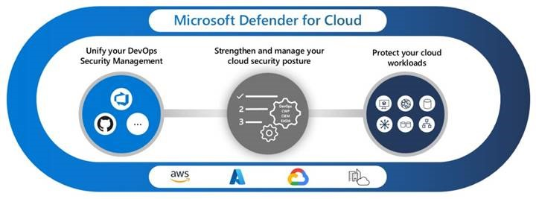
Why we use Microsoft defender for cloud:
By using Microsoft defender for cloud we can enhance our security in the environment. It protect our critical assets and reduce the risk of cyber attacks and any type of attacks.
It provides us the features and tools that detect , investigate and respond to advance threats.
So Microsoft has three components such as:

Slide 7
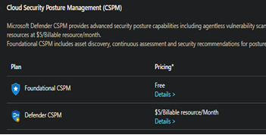
Cloud Security Posture Management:
Microsoft Defender for cloud continuously assess our environment for security vulnerabilities and misconfigurations and giving you hardening guidance so that you can efficiently and effectively improve your secure score.
Cloud security posture management (CSPM) is a process of ensuring that cloud resources are configured and deployed according to best practices and compliance standards.
Notes:
It's a process that makes sure all your cloud resources are set up the right way, following the best rules and guidelines. Imagine it as a security checklist for your cloud space – ensuring everything is in order, safe, and meets the rules everyone agrees upon.

Slide 8
Types of CSPM Capabilities:
Foundational CSPM - Defender for Cloud offers foundational multicloud CSPM capabilities for free. These capabilities are automatically enabled by default for subscriptions and accounts that onboard to Defender for Cloud.
Defender Cloud Security Posture Management (CSPM) plan - The optional, paid Defender for Cloud Secure Posture Management plan provides more, advanced security posture features.
Defender CSPM protects across all your multicloud workloads, but billing only applies for Servers, Database, and Storage accounts at $5/billable resource/month.
Defender CSPM capabilities, such as identifying and remediating security configuration issues across multiple cloud providers, and threat protection capabilities, such as anomaly detection and behavior-based alerting.
Notes:
Multi cloud--using services from different cloud providers rather than sticking to a single one.
Imagine having a security guard for your entire house, but you only pay for protecting your computer, important files, and storage spaces.
First, it can find and fix security problems in how your digital stuff is set up, whether it's in Google Cloud, AWS, or others. Second, it has a radar for unusual activities and warns you about them.

Slide 9
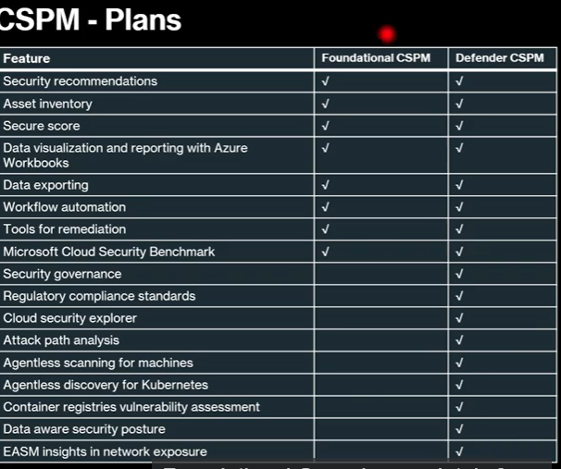
Notes:
Microsoft Defender for Cloud is like a security guard for your online stuff. It checks your cloud setup for any vulnerabilities, helps fix them to make everything more secure, and protects your data and applications from online threats, even if they're spread across different cloud services or a mix of online and offline environments.
provides a variety of security services to help protect your cloud resources.

Slide 10
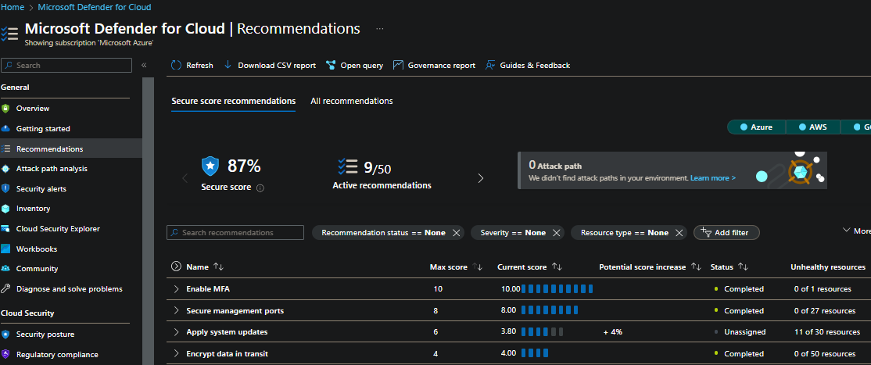
Security Recommendations:
The system continuously analyzes data from various sources such as logs, events from the Azure environment to detect potential security threats.
It then uses machine learning algorithms to identify patterns and anomalies in the data to identify potential security issues.
Based on this analysis, Microsoft Defender for Cloud Azure generates a set of recommendations that can help administrators address security issues and improve their overall security posture.
Notes:
"Data Analyzer," constantly looks at different types of information, like logs (think of them as detailed records), events (like actions happening), and telemetry (data about how things are working) in your Azure space.
when the Data Analyzer sees something acting out of the ordinary, it's like your detective's alarm bells ringing. the ability to learn from past experiences and quickly spot anything that doesn't quite fit the normal pattern—ML.

Slide 11
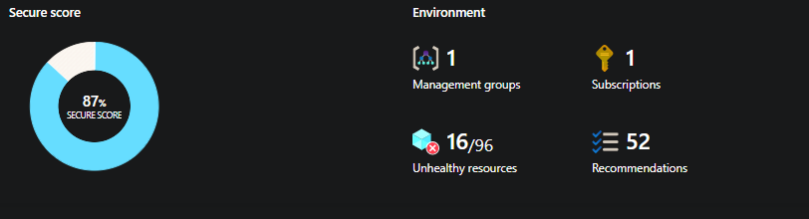
Secure score :
A secure score is a numerical value that represents the security posture of your cloud resources based on the security controls you have implemented.
The higher your secure score, the more secure your cloud environment is against potential threats and vulnerabilities.
Notes:
Think of a secure score like a grade for how safe your digital stuff is. The higher the score, the better your security.

Slide 12
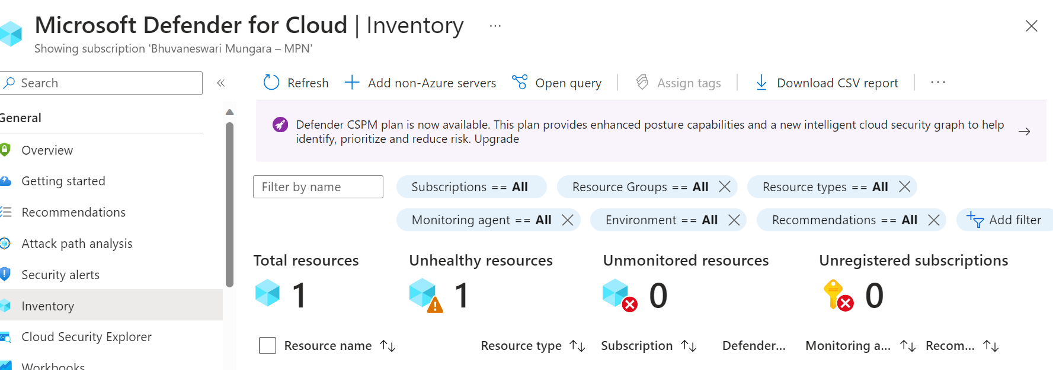
Inventory assets:
Inventory assets in Microsoft Defender for Cloud is like having a detailed list of all your belongings, but for your Azure cloud resources.
The purpose of maintaining an inventory of these assets is to help you understand what you have, where it is located, and how it is configured.
Notes:
So, just like checking if you have all your toys or clothes, you can use this inventory to make sure all your digital stuff is where it's supposed to be in the Azure cloud. It's like a superhero organizer for your virtual belongings.

Slide 13
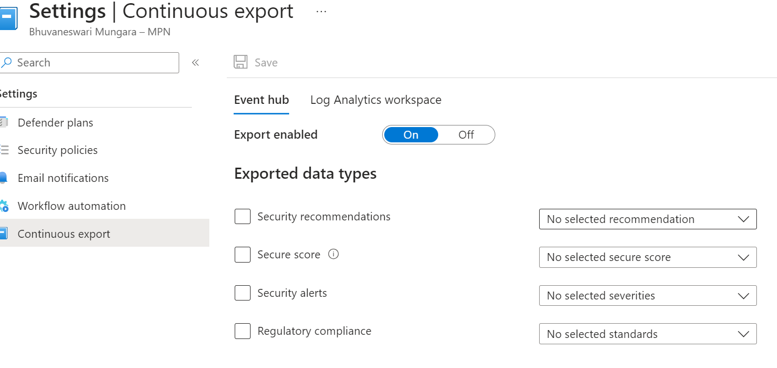
Data exporting:
Microsoft Defender for Cloud generates detailed security alerts and recommendations.
To analyze the information that's in these alerts and recommendations, you can export them to Log Analytics in Azure Monitor, to Azure Event Hubs.
Notes:
making a copy of important information about your digital security.
Think of it as creating a backup of your security details, so you have a handy reference or can share key information when needed.
Analyze--, visualize—before the 6months data, insights—how the data should be process

Slide 14
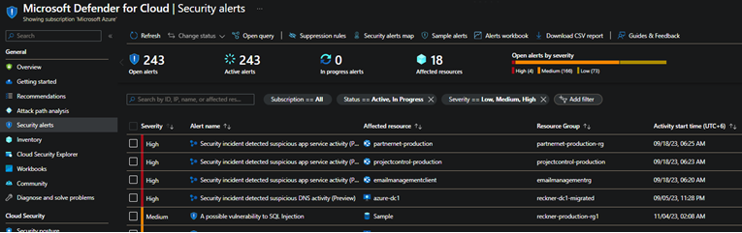
Security Alerts:
Defender for Cloud's security alerts is generated based on the detection of suspicious or malicious activity in an organization's Azure environment.
These alerts are generated by Microsoft's advanced threat protection capabilities, which leverage machine learning and behavioral analytics to identify potential threats and anomalies.
These alerts indicate possible malicious activities or vulnerabilities that could compromise your data and applications.

Slide 15
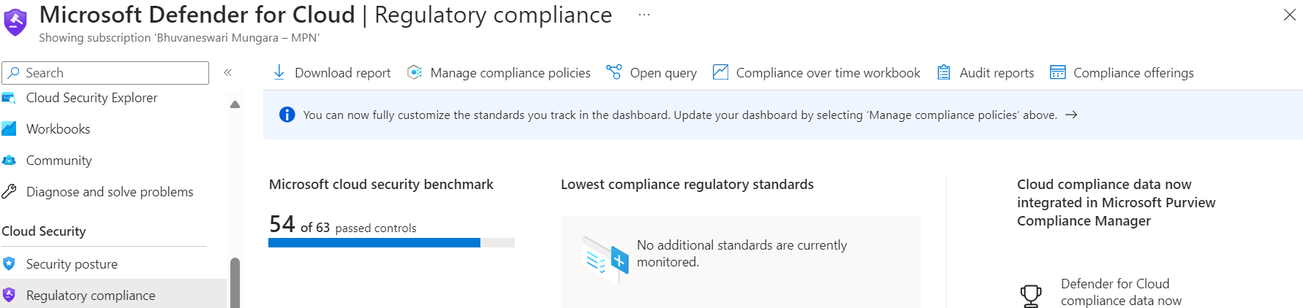
Regulatory compliance:
Microsoft Defender for cloud continuously compare the configuration of our resources with the requirement.
It is standard and set of rules, As you can see Microsoft security benchmark is applied by default on my subscription

Slide 16
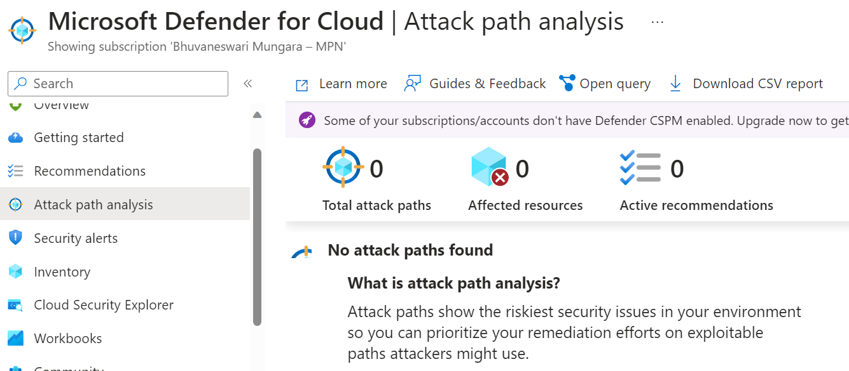
Attack Path Analysis:
A feature that helps identify and prioritize security risks in cloud environments.
It uses graph-based algorithms to map out the possible paths that an attacker can take to compromise resources.
It provides recommendations and actions to mitigate the threats and reduce the attack surface.
These techniques provide valuable insights into the security posture and vulnerabilities that attackers may exploit.

Slide 17
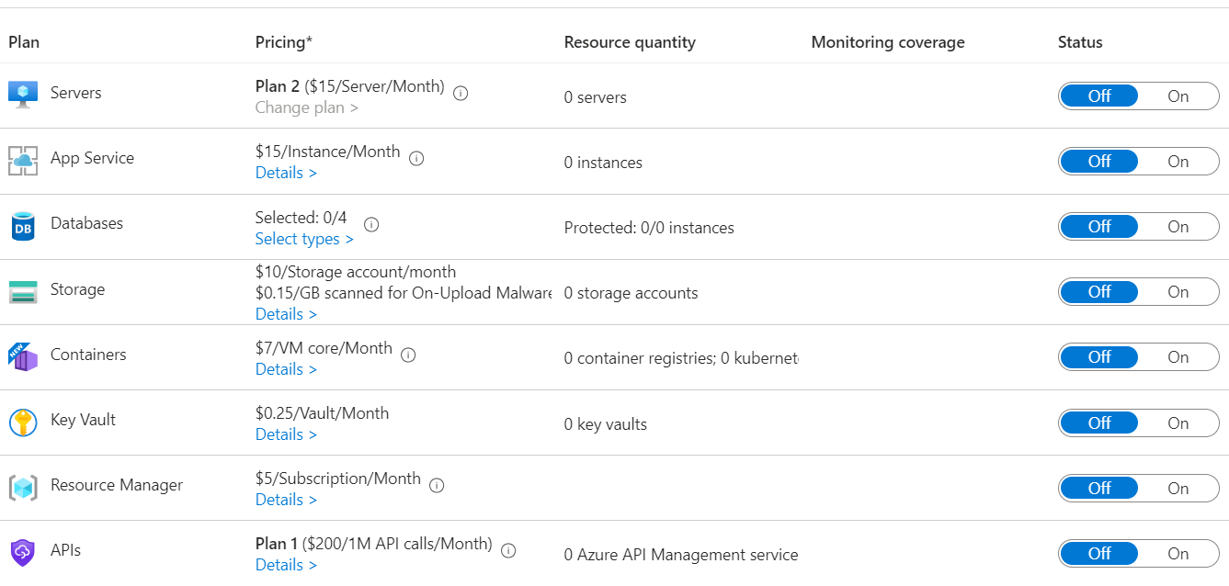
Cloud Security Workload Protection:
Cloud Workload Protection Management in Microsoft Defender for Cloud is a feature that provides security for your workloads across virtual machines (VMs), containers, databases, storage, app services, and more.
CWPM helps organizations protect their cloud workloads against cyber threats and attacks.

Slide 18
Defender for servers:
Enabling Defender for Servers on a subscription doesn't automatically protect the attached workspace. To ensure coverage for the workspace, you must separately enable Defender for Servers on the Log Analytics workspace itself.
Defender for endpoint-- Defender for Servers focuses on safeguarding your servers, while Defender for Endpoint watches over your devices.
Defender for Endpoint is like a guardian for each individual computer or device in your network. It protects them from viruses, malware, and other threats that could harm your system.
Automatic agent onboarding, alert and data integration:
Automatic Agent Onboarding: This feature automatically installs necessary agents on your devices or servers without you having to do it manually.
Alert Integration: It ensures that alerts from different sources are gathered and managed in one place, making it easier for you to stay on top of any potential issues.
Data Integration: This feature seamlessly combines data from various sources, providing a comprehensive view of your system's health and security.
Notes:
Devices are what you use to access and interact with your resources in the cloud, like your computer, tablet, or phone. They're the tools you use to connect to Azure services.
Servers, on the other hand, are the machines in the cloud that actually store and run your applications or services. They provide the computing power and storage needed to host your software or website.

Slide 19
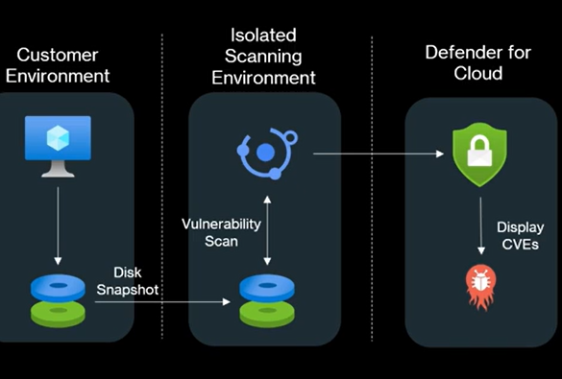
Agentless scanning-- Agentless scanning for VMs gathers information using cloud APIs. . On the other hand, agent-based methods use the operating system's own tools while it's running to constantly collect security-related data. It's like comparing two ways of gathering information.
Defender for Cloud takes snapshots of VM disks and performs an out-of-band, deep analysis of the operating system configuration and file system stored in the snapshot. The copied snapshot remains in the same region as the VM. The VM isn't affected by the scan.
After acquiring the necessary metadata is acquired from the copied disk, Defender for Cloud immediately deletes the copied snapshot of the disk and sends the metadata to Microsoft engines to detect configuration gaps and potential threats.
The analysis is done by Defender Vulnerability Management. The results are displayed in Defender for Cloud, which consolidates both the agent-based and agentless results on the Security alerts page.

Slide 20
Vulnerability assessment powered by qualyis:
Instead of using Defender Vulnerability Management, Defender for Cloud offers the option to deploy a Qualys scanner to find vulnerabilities. The scanner will identify any security issues, and you don't need your own Qualys license or account to use it.
Agent less secrete scanning:
If we have any important or sensitive information like passwords and credit card details without any encryption, it scans and provide recommendations to secure it.
It's a simple and efficient way to ensure that your sensitive data is kept safe, without adding any extra burden to your systems.
Provides guidelines to help investigate and mitigate identified threats:
It offers instructions to understand and deal with any security threats that are found. These guidelines help you figure out what the threat is, how serious it is, and what steps you can take to fix or lessen the risk.

Slide 21
Agentless malware detection :
Agentless malware scanning capability that scans and detects malware and viruses. The scanner is available for Azure virtual machines (VM), AWS EC2 instances and GCP VM instances.
Security alerts that are generated when malware is detected. These alerts provide extra details and context for investigations, and are sent to both the Defender for Cloud Alerts page and Defender XDR.
Resolve missing software updates gaps with Azure Update Manager:
Azure Update Manager helps fill in the gaps where software updates are missing on your Azure virtual machines.
It's like having a handy assistant that ensures your virtual machines are always up-to-date with the latest security patches and improvements. So, instead of manually checking and installing updates, Azure Update Manager does it automatically, keeping your virtual machines secure and running smoothly.
Notes:
eXtended Detection and Response, in Defender for Cloud in Azure is like having a super smart security system for your cloud environment.

Slide 22
Just in time access (VM):
Threat actors actively hunt accessible machines with open management ports, like RDP or SSH. All of your virtual machines are potential targets for an attack. When a VM is successfully compromised, it's used as the entry point to attack further resources within your environment.
In Azure, you can block inbound traffic on specific ports, by enabling just-in-time VM access. Defender for Cloud ensures "deny all inbound traffic" rules exist for your selected ports in the network security group (NSG) and Azure Firewall rules. These rules restrict access to your Azure VMs’ management ports and defend them from attack.
If the request is approved, Defender for Cloud configures the NSGs and Azure Firewall to allow inbound traffic to the selected ports from the relevant IP address (or range), for the amount of time that was specified.
After the time has expired, Defender for Cloud restores the NSGs to their previous states. Connections that are already established aren't interrupted.
Network layer threat detection:
Defender for Servers keeps an eye out for threats aimed at controlling your network. This includes spotting suspicious activities happening within Azure virtual machines.
Notes:
It watches the traffic flowing between your computers, servers, and other devices in the cloud, keeping an eye out for any signs of trouble, like suspicious activity or attempts to break in.

Slide 23
Cloud adaptive native applications:
This smart system automatically creates lists of safe applications for your devices based on data and intelligence.
Enabling and setting up adaptive application controls means you're telling your system which applications are allowed to run. If any other application tries to run, you'll receive a security alert.
Benefits of cloud adaptive native applications:
Identify potential malware, even any that antimalware solutions can miss
Identify software your organization banned but is nevertheless running on your machines.
Increase oversight of apps that access sensitive data.
File integrity monitoring:
It is like having a security guard for your computer files. It keeps an eye on important parts of your computer, like system files and settings, to make sure they haven't been changed in a suspicious way.
FIM alerts you so you can take action to protect your computer from potential attacks.
When you enable FIM, it sets up a special resource called Change Tracking Solution. This solution is like a control center where all the detected changes are gathered and analyzed. So, FIM with Change Tracking helps you stay aware of any alterations in your computer environment, helping you keep your files safe and secure.
It also lets you set up your own rules for what to monitor.

Slide 24
Adaptive network hardening:
It constantly watches the traffic coming in and out of your network, learning what's normal and what's suspicious.
Network hardening filters traffic to and from resources by using network security groups (NSGs) to improve your network security posture.
By enabling Defender for Cloud, They keep an eye on the traffic patterns and suggest ways to make your fences stronger based on what they see. This helps make your network even safer from potential threats.
Log Analytics 500MB free data ingestion:
you can send up to 500MB of your system's logs and data to Azure for analysis without any extra cost. This data includes information about security or anti-malware stuff, like keeping your computer safe from viruses.
The amount of free data you can send to the azure is measured by how many computers (nodes) are reporting to the workspace and how much data they send each day. So, if you have 10 computers reporting to the workspace and they send data every day, that's what's counted.
how much data is going into the azure and ensures that everyone's data needs are covered without any surprises in costs.

Slide 25
Defender for App service:
Azure App Service is a fully managed platform for building and hosting your web apps and APIs. Since the platform is fully managed, you don't have to worry about the infrastructure. It provides management, monitoring, and operational insights to meet enterprise-grade performance, security, and compliance requirements.
Microsoft Defender for App Service is like having a security guard for your website or app that's hosted on App Service in Azure. It uses the power of the cloud to keep an eye out for any bad guys trying to break into your website or app.
The Defender scans and looks out for these attempts, helping to keep your website or app safe from harm.
It also helps learn about new ways attackers might try to harm the system, so we can better protect against them in the future.
Benefits:
Secure-- Defender for App Service, looks at everything in your bundle and gives you suggestions on how to make it safer. These suggestions are like little tips on how to strengthen the security of your resources. You just need to follow the step-by-step instructions provided to make your App Service resources more secure.
Detect-- Defender for App Service keeps your website or app safe by keeping an eye on four main things:

Slide 26
The computer (VM) where your app is hosted and how it's managed: It watches over the computer itself to make sure it's secure and being taken care of properly.
The messages going to and from your app: It looks at the information going in and out of your app to catch any suspicious activity.
The safe areas where your app runs: It checks the environment where your app operates to make sure it's protected.
The records of what's happening inside your App Service: It examines the logs of your app to see if there are any signs of trouble, taking advantage of Azure's special access as a cloud provider.
if a bunch of sneaky villains were trying to break into your website from different computers all at once. It would be hard for regular security measures to catch them all because they're coming from different places. But Defender for App Service is like a super-powered guard that can see the big picture. It can spot when these bad guys are all working together, even if they're sneaking in from different places.
Even if Microsoft Defender is installed after an attack has already happened, it can still act like an alert guard, noticing ongoing attacks and helping to stop them. So, even if the castle's security wasn't perfect from the start, it can still catch and prevent trouble later on.

Slide 27
What threats can Defender for App Service detect?
Pre attack threats --These bad guys, called attackers, use special tools called vulnerability scanners to search for holes in applications. But Defender for Cloud is like a detective that can catch these attackers in the act. It can see when these scanners are being used and stop them before they cause any harm.
Initial access threats --Think of Microsoft Threat Intelligence as a big library of information about bad guys and their tricks.
So, it's like having a security guard who knows all the bad guys by their faces and warns you when a bad guy trying to connect to your Azure App Service FTP interface, helping you keep your digital space secure.
Execution threats--High privilege commands: These are commands that could do serious damage if they're run without permission, like changing important settings or accessing sensitive information.
Cross-Platform Commands: If someone tries to execute commands that are meant for a different operating system (like trying to run Linux commands on a Windows system), it could indicate a security risk or suspicious activity.
Digital Currency Mining Tools: These are programs that can be covertly installed and used to hijack system resources for cryptocurrency mining. Defender for App Service detects and blocks such activities to prevent unauthorized resource usage and potential performance issues.

Slide 28
Dangling DNS detection:
DNS registrar as a big directory that keeps track of website addresses. Sometimes, when a website is shut down or changed, its address might still be listed in this directory, but it doesn't lead anywhere.
If we created one website or app service and you associated one domain name after some days, you deleted app service but domain name is still active but you are unable to open app because of it deleted. So by using domain names attacker bind their own apps like malicious apps. Now any one of us try hit the domain then they are to get hacked because they went to malicious apps. These type domains names are identified by dangling DNS detection.

Slide 29
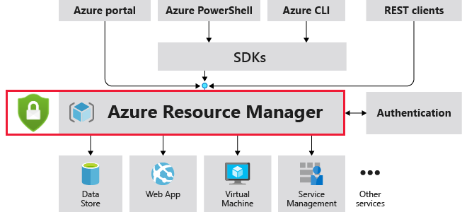
Defender for Azure Resource manager:
It is the deployment and management service for Azure. It provides a management layer that enables you to create, update, and delete resources in your Azure account. You use management features, like access control, locks, and tags, to secure and organize your resources after deployment.
Microsoft Defender for Resource Manager automatically monitors the resource management operations in your organization, whether they're performed through the Azure portal, Azure REST APIs, Azure CLI, or other Azure programmatic clients.
Defender for Cloud runs advanced security analytics to detect threats and alerts you about suspicious activity.

Slide 30
Benefits of resource manager:
Suspicious resource management operations, such as operations from malicious IP addresses, disabling antimalware, and suspicious scripts running in VM extensions.
Use of exploitation toolkits like Microburst or PowerZure. are like digital toolboxes for hackers.
Lateral movement from the Azure management layer to the Azure resources data plane.
Notes:
They contain software that helps them find weaknesses or "exploits" in computer systems or networks.

Slide 31
Defender for key vault:
Azure Key Vault is a cloud service that safeguards encryption keys and secrets like certificates, connection strings, and passwords.
Enable Microsoft Defender for Key Vault for Azure-native, advanced threat protection for Azure Key Vault, providing an additional layer of security intelligence.
Benefits:
Microsoft Defender for Key Vault detects unusual and potentially harmful attempts to access or exploit Key Vault accounts. This layer of protection helps you address threats even if you're not a security expert, and without the need to manage third-party security monitoring systems.
When anomalous activities occur, Defender for Key Vault shows alerts and optionally sends them via email to relevant members of your organization. These alerts include the details of the suspicious activity and recommendations on how to investigate and remediate threats.

Slide 32
Respond to defender for azure key vault:
When you receive an alert from Microsoft Defender for Key Vault, we recommend you investigate and respond to the alert.
Microsoft Defender for Key Vault protects applications and credentials, so even if you're familiar with the application or user that triggered the alert, it's important to verify the situation surrounding every alert.

Slide 33
Defender for storage:
Microsoft Defender for Storage is an Azure-native layer of security intelligence that detects potential threats to your storage accounts. It helps prevent the three major impacts on your data and workload: malicious file uploads, sensitive data exfiltration, and data corruption.
Defender for Storage includes:
Activity Monitoring
Sensitive data threat detection (preview feature, new plan only)
Malware Scanning (new plan only)
Benefits of defender for storage: Better protection against malware: The Malware Scanning scans and detects in near real-time all file types, including archives of every uploaded blob, and provides fast and reliable results, helping you prevent your storage accounts from acting as an entry and distribution point for threats.

Slide 34
Detection of entities without identities: Defender for Storage helps detect and alert you about potential unauthorized access to your files caused by leaked or compromised keys, allowing you to tighten security and prevent data breaches.
Comprehensive security without enabling logs: When you turn on Microsoft Defender for Storage, It keeps an eye on everything happening in Azure Blob Storage, Azure Files, and Azure Data Lake Storage without needing you to specifically turn on logs for it to work.
Activity monitoring
When you enable it, it automatically keeps an eye on your storage accounts, checking both the data you store and the controls you have in place. You don't have to separately turn on any extra logging to get these security benefits.
It sends you alerts if it notices anything suspicious, but it's smart enough not to bombard you with too many alerts about the same thing. Plus, it does all this without slowing down your storage or causing any problems accessing your data.
Notes:
* is designed to protect your data and resources thoroughly without needing to record detailed logs of every action or event that occurs. without needing to constantly monitor and record every movement inside. The security measures in place ensure protection without the need for detailed logging of activities.

Slide 35
Malware scanning:
Malware Scanning in Defender for Storage helps protect storage accounts from malicious content by performing a full malware scan on uploaded content in near real time, applying Microsoft Defender Antivirus capabilities.
It's designed to help fulfill security and compliance requirements to handle untrusted content. Every file type is scanned, and scan results are returned for every file.
Sensitive data threat detection
The "sensitive data threat detection" capability helps security teams quickly figure out which security alerts are most important to look into. It does this by checking how sensitive the data at risk is. This helps them find potential problems faster and stop data breaches from happening.
the "Sensitive Data Discovery" engine. This tool doesn't need to be installed on your computer like regular software - it's "agentless." Instead, it works like a detective, searching your files and folders to find any sensitive information you might have, like passwords or personal details. that uses a smart sampling method to find resources with sensitive data.
By integrating this service with Purview, it means that the service can automatically understand and follow the same rules for handling sensitive information that you've set up in Purview.

Slide 36
Per storage account pricing
The new Microsoft Defender for Storage plan has predictable pricing based on the number of storage accounts you protect.
With the new plan, you pay a set price based on how many storage areas you want to protect. You can choose to protect everything in your subscription or just specific areas. Plus, you can decide which storage areas you don't need protection for.
The pricing plan makes it easy to figure out how much you'll pay as your needs grow. If you use a lot of storage, there might be extra charges. But overall, it's designed to be straightforward and flexible.
Malware Scanning - Billing per GB, monthly capping, and configuration
You can set a limit on how much space all your storage accounts combined can use. Or, you can set limits for each storage account separately. If you have extra protection on your subscription, you can have different limits for different storage accounts. It's like deciding how much room each box can take up in your storage unit, either for each box separately or for all the boxes together.
By default, the limit is set to 5,000 GB per month per storage account. Once this threshold is exceeded, scanning will cease for the remaining blobs, with a 20-GB confidence interval.
Now, if you try to put more items in the box after reaching the limit, only the first 20 items will be checked. If they fit within the limit, they'll be allowed in. But if they don't, you won't be able to add any more items until the next month.

Slide 37
Defender for containers:
Microsoft Defender for Containers is a cloud-native solution to improve, monitor, and maintain the security of your containerized assets and their applications, across multicloud and on-premises environments.
Defender for Containers assists you with four core domains of container security:
Security posture management
Agentless capabilities
Agentless discovery for Kubernetes - provides zero footprint, API-based discovery of your Kubernetes clusters, their configurations and deployments.
Agentless vulnerability assessment - provides vulnerability assessment for all container images, including recommendations for registry and runtime, quick scans of new images, daily refresh of results, exploitability insights, and more.
Comprehensive inventory capabilities - allow you to easily keep track of and manage all the different parts of your system, like resources, services, and configurations.
Control plane hardening - It's where you manage and configure everything, like setting permissions and creating new containers.

Slide 38
Agent-based capabilities: Kubernetes data plane hardening means making your Kubernetes setup more secure to protect your containerized workloads. One way to do this is by installing Azure Policy for Kubernetes, which provides best practice recommendations for security.
ii) Vulnerability assessment: It provides agentless vulnerability assessment for Azure, AWS, and GCP with remediation guidelines, zero configuration, daily rescans, coverage for OS and language packages, and exploitability insights.
It looks at both the operating system and any software you're using and gives you advice on how to fix any problems it finds .It also gives you insights into how likely it is that someone could exploit any vulnerabilities it finds.
iii)Run-time protection for Kubernetes nodes and clusters
Not only does this tool detect threats, but it also responds automatically to them. And if you're using other security tools like or XDR ,it can seamlessly integrate with them, giving you a more comprehensive view of your system's security status.
Threat protection is provided for Kubernetes at cluster level, node level, and workload level and includes both agent based coverage that requires the Defender agent and agentless coverage that is based on analysis of the Kubernetes audit logs.
Notes:
MITRE ATT&CK framework categorizes different types of cyber threats, making it easier for you to grasp what's happening and how serious it is.

Slide 39
iv) Deployment & monitoring- Monitors your Kubernetes clusters for missing agents and provides frictionless at-scale deployment for agent-based capabilities, support for standard Kubernetes monitoring tools, and management of unmonitored resources.
Defender for Containers architecture:
Defender for Containers is designed differently for each Kubernetes environment whether they're running in:
Azure Kubernetes Service (AKS) - Microsoft's managed service for developing, deploying, and managing containerized applications.
Amazon Elastic Kubernetes Service (EKS) is like having your own personal team of experts to manage and run Kubernetes, a popular tool for managing software applications. With EKS, you don't have to worry about setting up or maintaining the technical stuff; Amazon takes care of that for you.
Google Kubernetes Engine (GKE) is like a special area in Google's cloud where you can put your applications. It's managed by Google, which means they take care of a lot of the technical stuff like setting up servers and making sure everything runs smoothly. You can use it to run your apps, manage them, and make them bigger or smaller depending on how much traffic they're getting.
An unmanaged Kubernetes distribution -you have a bunch of containers running your apps. Kubernetes helps manage these containers, making sure they run smoothly. Azure Arc extends this to manage Kubernetes clusters whether they're on your own servers or on a cloud provider like Azure.
Notes:
if you're using Amazon EKS to run your Kubernetes clusters, Azure Defender for Cloud can help protect those clusters from security threats and vulnerabilities, even though they're not hosted on Azure.

Slide 40
Architecture for each Kubernetes environment
When Defender for Cloud safeguards an Azure Kubernetes Service (AKS) cluster, it gathers audit log information without needing any special software installed. This data is automatically gathered through Azure's systems, without extra fees or setup hassle.
These are the required components in order to receive the full protection offered by Microsoft Defender for Containers:
Defender agent:
you have a group of computers. The Defender agent is like a special protector assigned to each computer. It uses a fancy technology called eBPF to keep an eye on what's happening on each computer, almost like a super detective. It then sends this information to a special place called a Log Analytics workspace, kind of like a central hub for all the detective work. However, the audit log data isn't stored in the Log Analytics workspace.
Azure Policy for Kubernetes: A pod that extends the open-source Gatekeeper v3 and registers as a web hook to Kubernetes admission control making it possible to apply at-scale enforcements, and safeguards on your clusters in a centralized, consistent manner.
The Azure Policy for Kubernetes pod is deployed as an AKS add-on. It's only installed on one node in the cluster.
Notes:
By registering Gatekeeper as a web hook to Kubernetes admission control, it means that every or pod has to go through Gatekeeper before it's allowed to grow. This helps you enforce rules and keep your cluster healthy and organized. And because it's centralized, you can apply these rules consistently across all the different parts of your cluster.
So, only one node in your cluster has the rulebook, while the others might not know about it.

Slide 41
Defender for Azure SQL databases:
Azure SQL Database is a cloud-based solution for storing and working with your data, without the hassle of managing servers yourself.
it as a secure, scalable, and managed version of Microsoft SQL Server that lives in the cloud. You can use it to store structured data, run queries to retrieve information, and even build applications that rely on this data without having to worry about the underlying infrastructure.
Benefits of defender for azure SQL database:
Discover and mitigate vulnerabilities:
Assessment scans provide an overview of your SQL machines' security state, and details of any security findings. Defender for Azure SQL helps you identify and mitigate potential database vulnerabilities and detecting anomalous activities that could indicate threats to your databases.
Advanced threat protection:
An advanced threat protection service continuously monitors your SQL servers for threats such as SQL injection, brute-force attacks, and privilege abuse. This service provides action-oriented security alerts in Microsoft Defender for Cloud with details of the suspicious activity, guidance on how to mitigate to the threats, and options for continuing your investigations with Microsoft Sentinel.

Slide 42
Threat intelligence enriched security alerts are triggered when there's:
Potential SQL injection attacks - including vulnerabilities detected when applications generate a faulty SQL statement in the database. Specifically, it looks for issues where your software might accidentally create weak spots in your database security.
Anomalous database access and query patterns - for example, an abnormally high number of failed sign-in attempts with different credentials (a brute force attempt)
Suspicious database activity - for example, a legitimate user accessing an SQL Server from a breached computer which communicated with a crypto-mining C&C server.
What is SQL vulnerability assessment:
SQL vulnerability assessment is a service that provides visibility into your security state. Vulnerability assessment includes actionable steps to resolve security issues and enhance your database security. It can help you to monitor a dynamic database environment where changes are difficult to track and improve your SQL security posture. In a dynamic database environment where things are always changing, it's hard to keep track of what's going on.
You can customize an assessment report for your environment by setting an acceptable baseline for:
Permission configurations
Feature configurations
Database settings
Notes:
PSIA--When applications create SQL statements incorrectly, it can create vulnerabilities in your database security. It's like leaving a weak spot in the lock of your digital door, making it easier for sneaky burglars to break in.
.
Vulnerability assessment helps by keeping an eye on these changes and making sure your database stays safe and secure.
These are settings that determine who can do what within a system or application.
This refers to how different features or functions within a system or application are set up.
Databases are like organized collections of data, and they have settings that determine how they operate. ideal configurations for things like access controls, encryption, backups, etc.

Slide 43
What are the express and classic configurations?
You can configure vulnerability assessment for your SQL databases with either:
Express configuration is a simple setup that allows you to do vulnerability assessments without needing to save your baseline (initial setup) and scan results elsewhere. Basically, you can do the assessment without relying on other storage systems.
Express configuration is quick and doesn't need a storage account. It's a simpler option.
In a classic configuration, you'd use an Azure storage account to store two types of data: baseline data and scan result data.
Baseline data is like a reference point or template that shows what your system should ideally look like. Scan result data is the information collected when you check your system against this baseline to see if everything is as it should be or if there are any issues
So, normally in Azure SQL databases, if you want to check for security vulnerabilities, you need to set up a storage account to store the assessment results. But with the express configuration, you can skip this step and directly view the assessments without needing a storage account.

Slide 44
Investigation threats: SQL Advanced Threat Protection
Advanced Threat Protection is part of the Microsoft Defender for SQL offering. Advanced Threat Protection is a special feature in this bodyguard package that gives extra security against advanced attacks. You can control and monitor all these protections from one central place, the Microsoft Defender for SQL portal, making it easier to keep your database safe.
Think of auditing like having a detective follow every move your database makes. When auditing is enabled, every action taken on your database is recorded in a special log stored in your Azure storage account. So, if something goes wrong or you need to investigate, you can check the audit log to see exactly what happened and who did it.
Explore detection of a suspicious event
You receive an email notification upon detection of anomalous database activities. The email provides information on the suspicious security event including the nature of the anomalous activities, database name, server name, application name, and the event time. In addition, the email provides information on possible causes and recommended actions to investigate and mitigate the potential threat to the database.

Slide 45
Microsoft Defender for SQL servers on machines:
Defender for SQL protects your IaaS SQL Servers by identifying and mitigating potential database vulnerabilities and detecting anomalous activities that could indicate threats to your databases.
Assessment scans provide an overview of your SQL machines' security state and provide details of any security findings.
Defender for SQL servers on machines protects your SQL servers hosted in Azure, multicloud, and even on-premises machines.
Set up Microsoft Defender for SQL servers on machines
The Defender for SQL server on machines plan requires Microsoft Monitoring Agent (MMA) or Azure Monitoring Agent (AMA) to prevent attacks and detect misconfigurations. The plan’s auto provisioning process is automatically enabled with the plan and is responsible for the configuration of all of the agent components required for the plan to function. This includes installation and configuration of MMA/AMA, workspace configuration, and the installation of the plan’s VM extension/solution.
Notes:
Defender for Cloud populates with alerts when it detects suspicious database activities, potentially harmful attempts to access or exploit SQL machines, SQL injection attacks, anomalous database access, and query patterns.

Slide 46
Microsoft Defender for open-source relational databases:
Defender for Cloud detects anomalous activities indicating unusual and potentially harmful attempts to access or exploit databases. The plan makes it simple to address potential threats to databases without the need to be a security expert or manage advanced security monitoring systems.
Benefits of Microsoft Defender for open-source relational databases:
These alerts appear in Defender for Cloud's security alerts page and include:
Suspicious Activity Details: These alerts show what unusual actions or events happened that caught Defender for Cloud's attention.
MITRE ATT&CK Tactic: This is a framework used to understand cyber threats. It categorizes attacks into tactics and techniques.
Recommended Actions: This tells you what steps to take next. It could be investigating further to understand the threat better or taking immediate actions to stop it.
Options with Microsoft Sentinel: If you need to dig deeper into the alert or connect it with other security data, Microsoft Sentinel provides more advanced tools for analysis and response.

Slide 47
What kind of alerts does Microsoft Defender for open-source relational databases provide?
Threat intelligence enriched security alerts are triggered when there are:
Anomalous database access and query patterns - For example, an abnormally high number of failed sign-in attempts with different credentials (a brute force attempt)
Suspicious database activities - For example, a legitimate user accessing an SQL Server from a breached computer which communicated with a crypto-mining C&C server
Brute-force attacks – With the ability to separate simple brute force from brute force on a valid user or a successful brute force
Respond to security alerts:
In the Azure portal:
Microsoft Defender for Cloud's security alerts page - Shows alerts for all resources protected by Defender for Cloud in the subscriptions you've got permissions to view.
The resource's Microsoft Defender for Cloud page - Shows alerts and recommendations for one specific resource, as shown above in Enable enhanced security.
Respond to email notifications: Defender for Cloud sends email notifications when it detects anomalous database activities. The email includes details of the suspicious security event such as the nature of the anomalous activities, database name, server name, application name, and event time.

Slide 48
Microsoft Defender for Azure Cosmos DB:
Azure Cosmos DB is like a super-powered database in the cloud. It can store and manage massive amounts of data from any where in the world, and it's designed to be really fast and scalable.
Microsoft Defender for Azure Cosmos DB detects potential SQL injections, known bad actors based on Microsoft Threat Intelligence, suspicious access patterns, and potential exploitation of your database through compromised identities, or malicious insiders.
You can enable protection for all your databases (recommended), or enable Microsoft defender for azure cosmos DB at either the subscription level, or the resource level.

Slide 49
What are the benefits of Microsoft Defender for Azure Cosmos DB:
Microsoft Defender for Azure Cosmos DB uses advanced threat detection capabilities and Microsoft Threat Intelligence data. Defender for Azure Cosmos DB continuously monitors your Azure Cosmos DB accounts for threats such as SQL injection, compromised identities and data exfiltration.
This service provides action-oriented security alerts in Microsoft Defender for Cloud with details of the suspicious activity and guidance on how to mitigate (how to fix them) the threats. You can use this information to quickly remediate security issues and improve the security of your Azure Cosmos DB accounts.
Alerts include details of the incident that triggered them, and recommendations on how to investigate and remediate threats. Alerts can be exported to Microsoft Sentinel or any other third-party SIEM or any other external tool.

Slide 50
Alert types:
Threat intelligence security alerts are triggered for:
Potential SQL injection attacks: Due to the structure and capabilities of Azure Cosmos DB queries, many known SQL injection attacks can’t work in Azure Cosmos DB. In Azure Cosmos DB, the way queries are set up makes it really hard for sneaky hackers to use SQL injection attacks.
Defender for Azure Cosmos DB detects both successful and failed attempts, and helps you harden your environment to prevent these threats.
Anomalous database access patterns: For example, access from a TOR exit node, known suspicious IP addresses, unusual applications, and unusual locations.
Suspicious database activity: For example, suspicious key-listing patterns that resemble known malicious lateral movement techniques and suspicious data extraction patterns.

Slide 51
Defender for API’s:
It's a special plan from Microsoft Defender for Cloud that keeps your APIs safe from start to finish. It protects them all the way from when they're created to when they're not needed anymore. If any bad guys try to attack your APIs, Defender for APIs jumps into action, detects the threat, and responds to stop them, keeping your online programs safe and secure.
To activate Defender for APIs, you can either do it from the Defender for Cloud portal, which is like the central command center for all security measures, or directly within the Azure portal where you manage your APIs.
What can I do with Defender for APIs?
Inventory: In a single dashboard, get an aggregated view of all managed APIs.
Security findings: Analyze API security findings, including information about external, unused, or unauthenticated APIs.
Security posture: Review and implement security recommendations to improve API security posture, and harden at-risk surfaces.
API data classification: Classify APIs that receive or respond with sensitive data, to support risk prioritization.

Slide 52
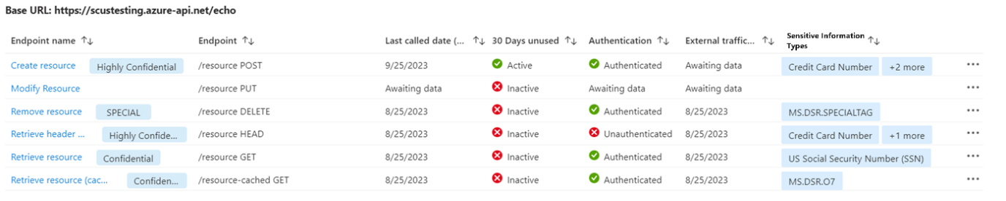
Threat detection: Ingest API traffic and monitor it with runtime anomaly detection, using machine-learning and rule-based analytics, to detect API security threats, including the OWASP API Top 10 critical threats.
Defender CSPM integration: Integrate with Cloud Security Graph in Defender Cloud Security Posture Management (CSPM) for API visibility and risk assessment across your organization.
SIEM integration: Integrate with security information and event management (SIEM) systems, making it easier for security teams to investigate with existing threat response workflows.
Reviewing API security findings
Review the inventory and security findings for onboarded APIs in the Defender for Cloud API Security dashboard. The dashboard shows the number of onboarded devices, broken down by API collections, endpoints, and Azure API Management services:

Slide 53
API endpoint information includes:
Endpoint name: The name of API endpoint/operation as defined in Azure API Management.
Endpoint: The URL path of the API endpoints, and the HTTP method. Last called data (UTC): The date when API traffic was last observed going to/from API endpoints (in UTC time zone).
30 days unused: Shows whether API endpoints have received any API call traffic in the last 30 days. APIs that haven't received any traffic in the last 30 days are marked as Inactive.
Authentication: Shows when a monitored API endpoint has no authentication. Defender for APIs assesses the authentication state using the subscription keys, JSON web token (JWT), and client certificate configured in Azure API Management. If none of these authentication mechanisms are present or executed, the API is marked as unauthenticated.
External traffic observed date: The date when external API traffic was observed going to/from the API endpoint.
Data classification: Classifies API request and response bodies based on supported data types.

Slide 54
Investigating API recommendations:
Use recommendations to improve your security posture, harden API configurations, identify critical API risks, and mitigate issues by risk priority.
Defender for API provides a number of recommendations, including recommendations to onboard APIs to the Defender for API plan, disable and remove unused APIs, and best practice recommendations for security, authentication, and access control.
Detecting threats
Defender for APIs monitors runtime traffic and threat intelligence feeds, and issues threat detection alerts. API alerts detect the top 10 OWASP API threats, data exfiltration, volumetric attacks, anomalous and suspicious API parameters, traffic and IP access anomalies, and usage patterns.
Responding to threats
Act on alerts to mitigate threats and risk. Defender for Cloud alerts and recommendations can be exported into SIEM systems such as Microsoft Sentinel, for investigation within existing threat response workflows for fast and efficient remediation.

Slide 57


Slide 58



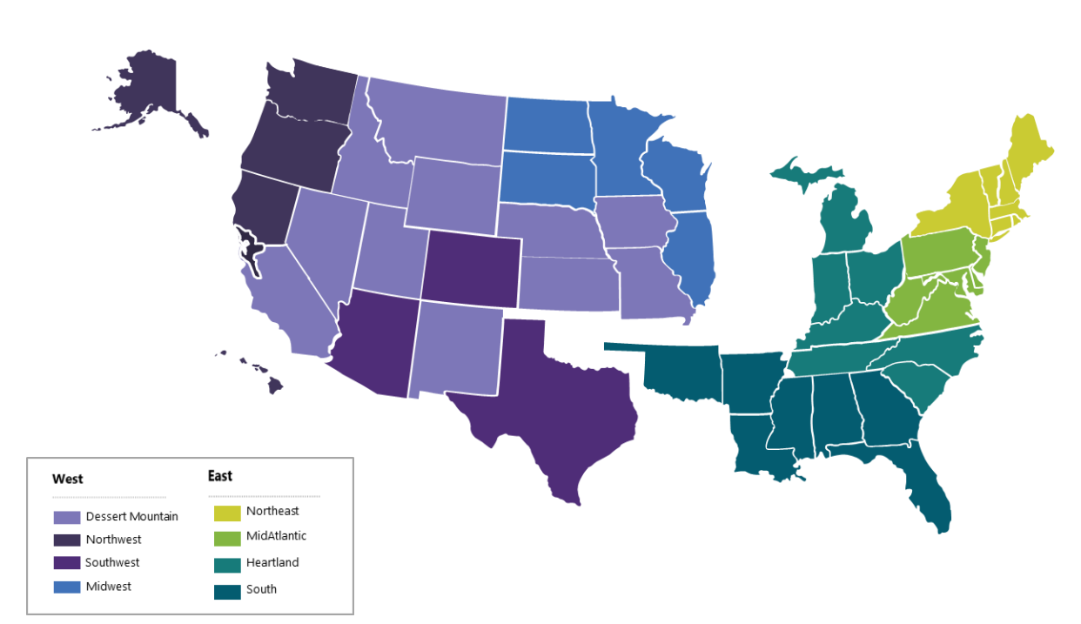

Contact Us:
Company Headquarters
SNP Technologies, 2319 Whitney Avenue, Suite 3C Hamden, CT 06518-3535,
(203) 287-9114
Sachin Parikh
VP of Business Development
sachin@snp.com
203-287-9114 X 112
Phil Balogh
Director Sales- North -USA
phil@snp.com
203-228-0310
Emerging/Investment
Market
Established
Market
Michael Fiorito
Director Sales- South- USA
Michael.fiorito@snp.com
917-753-0346
100% focused in SMC

Slide 59
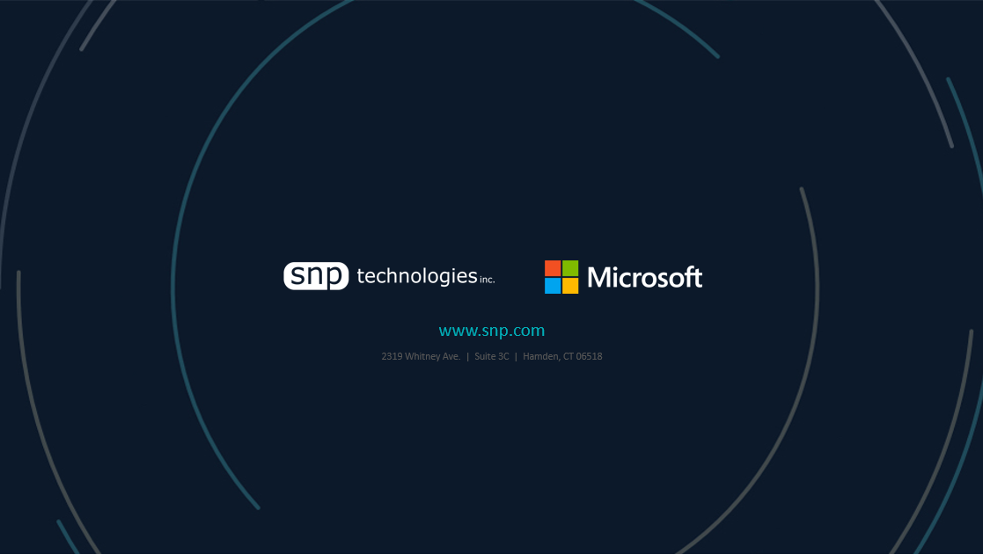

www.snp.com
2319 Whitney Ave. | Suite 3C | Hamden, CT 06518

